Slide 1
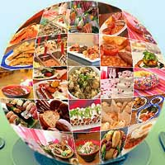
Food Around the World

Slide 2
Food in US and Japan
Grade: 3rd

Slide 3
Unit Plan
Unit: Food Around the World
Unit Theme: Food in US and Japan
Previous knowledge:
Students have one-year Japanese learning experience and have been
learning a variety of communicative dialogs (e.g., yes-no and wh-question
words) with vocabulary words by what they have learned.

Slide 4
Food Around the World: Food in US and Japan
Lesson 1:
Food and school lunch menus in US and Japan
Lesson 2:
Favorite food
Lesson 3:
Talk about more food
Lesson 4:
Healthy or unhealthy foods and school lunch time in US and Japan
Lesson 5:
Japanese table manners

Slide 5
Grammar modules in this unit
Na-adjectives for the JLPT N4
Use an opposite adjective, non-negative form
Kanji | Furigana | Romaji | Meaning
好き | すき | suki | like, love
すしがすきです。
Sushi ga suki desu. I like sushi.
嫌い | きらい | kirai | to not like
すしがきらいです。
Sushi ga kirai desu. I do not like sushi.
What (nani ga なにが) or (nani なん)
なにが すきですか。Nani ga suki desu ka. What do you like?
なにが きらいですか。Nani ga kirai desu ka. What do you dislike?
Ranking
rank | 番 | ばん | ban | 一番 (ichiban), 二番 (niban),….

Slide 6
Day 1 Lesson

Slide 7
Topic of Day
Food and School Lunch Menus in
US & Japan

Slide 8
Objectives
Students will be able to speak ten food items with five from each country.
Students will be able to recognize that the pronunciations of names of American food items whose sounds are close to what they normally pronounce.

Slide 9
Description of activities
Has students show school lunch menu in the US and Japan.
Reads some menu items to them in both languages.
Gives pronunciation practice for ten food items using picture cards.
Shows sample school lunches in the US and Japan and asks the food names using “what is this?” in Japanese (they have learned).
Gives homework with a matching drill and has them use teacher’s website to practice today’s words.

Slide 10
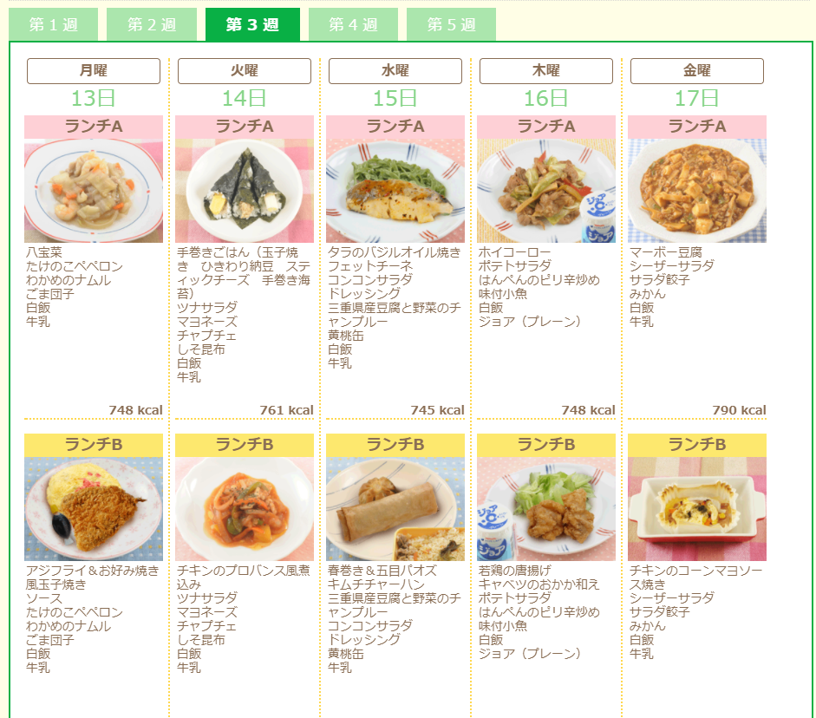
School Lunch Menu in US & Japan
http://www.seinan.ed.jp/es/menu/

Slide 11
Vocabulary words on food items
Food from US:
Bread
Hamburger
Pizza
Pasta
Sandwich
Food from Japan:
Steamed rice
Sushi
Ramen
Soba (buckwheat noodles)
Spaghetti

Slide 12

Food from US
パン(pan) Bread
ハンバーガー (hanbaagaa) Hamburger
ピザ (piza) Pizza
パスタ(pasuta) Pasta
サンドイッチ(sandoitchi) Sandwich

Slide 13
Food from Japan
ごはん(gohan) Steamed rice
すし(sushi) Sushi
ラーメン(raamen) Ramen
そば(soba) Buckwheat noodles
スパゲティー(supagetii) Spaghetti

Slide 14
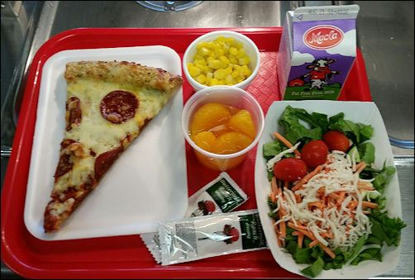
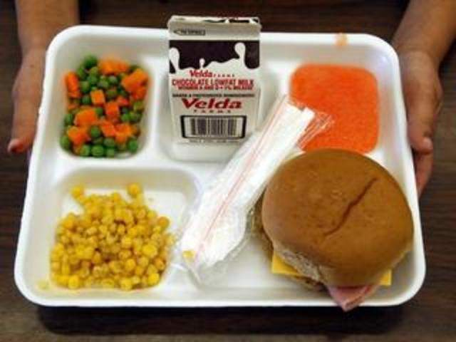
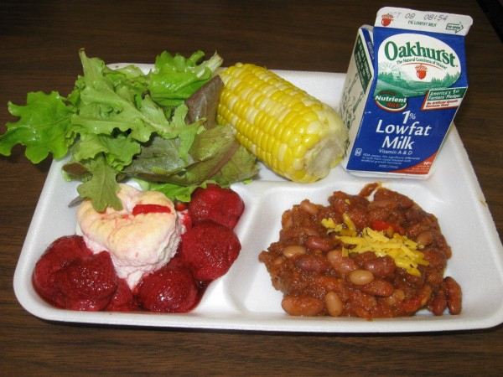
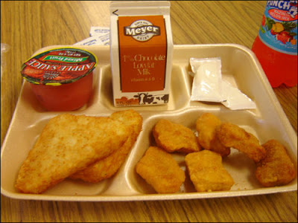
Sample school lunches in the US

Slide 15
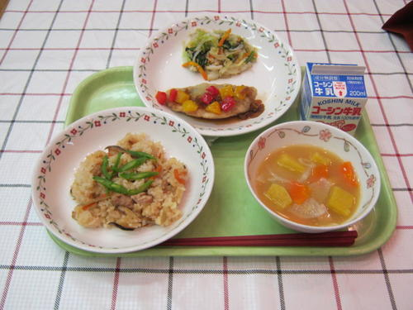
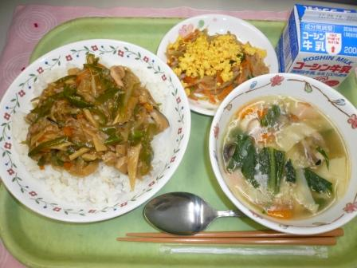
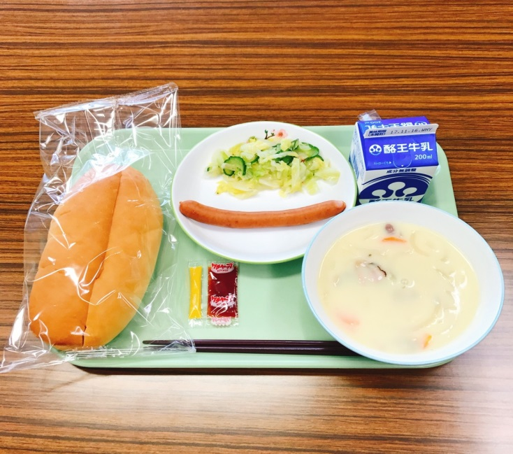
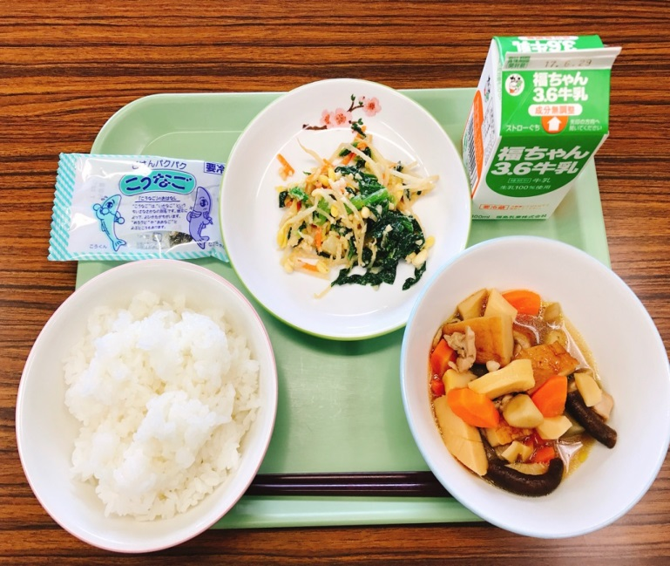
Sample school lunches in Japan

Slide 16
Homework
Do worksheet A
Practice the 10 words with sound files on teacher’s website

Slide 17
Day 2 Lesson

Slide 18
Topic of Day
Favorite food

Slide 19
Objectives
Students will be able to ask and respond to their favorite or disliked foods.
Students will be able to share their own and friends’ favorite and disliked foods in class.

Slide 20
Description of activities
As review from lesson 1, shows the facial expressions for love food or hate food and then Teacher says food items to have students respond either “Good (oishii)!!” or “Not good (mazui)!!”
Has students listen to the dialog 1, repeat, and speak together for three times.
Asks them to find three different partner in pairs in turn to practice the dialog 1 by substituting their choices of food (like or dislike).
Has students represent in class about own and one of the classmates’ favorite and disliked food by talking “I like ___. I do not like ___. Kate likes _____. Kate does not like ____.”

Slide 21
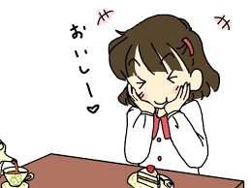
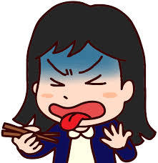
Does she love or hate the food?
まずい！
おいしい！
Oishii!
Mazui!

Slide 22
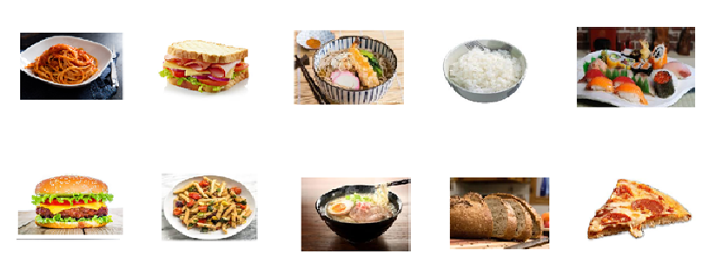
Dialog 1
A: ____がすきですか。
B1: はい, すきです。
B2: いいえ, きらいです。
A: ____ga suki desu ka. (Do you like ___?)
B1: Hai, suki desu. (Yes, I do. )
B2: Iie, kirai desu. (No, I dislike it.)

Slide 23
Presentation assignment
Choose your own and one of the conversional partners’ favorite
and disliked food to present to class.
わたしは、＿＿が すきです。 Watashi wa ___ga suki desu.
わたしは、＿＿が きらいです。 Watashi wa___ ga kirai desu.
ケイトは、＿＿が すきです。 Keito wa ___ga suki desu.
ケイトは、＿＿が きらいです。 Keito wa___ga kirai desu.
See Rubric A

Slide 24
Rubric on Presentation
See attachment.

Slide 25
Homework
Do worksheet B
Practice the words and dialog with sound files on the website

Slide 26
Day 3 Lesson

Slide 27
Topic of Day
Talk about more food

Slide 28
Objectives
Students will be able to learn wh-question words to communicate with each other.
Students will be able to add more food items by own.

Slide 29
Description of activities
As review from lesson 2, asks students to find a partner if he or she likes the animal meat on pictures using “Do you like__?
Has students listen to dialog 2, repeat, and speak together for three times.
Asks students to find three different partners in pairs to practice dialog 2 by substituting items of food and responding.
Asks students to make a group based on their favorite food and work with distributed worksheet to find food from the most to least popular ones and write the food items either in hiragana or katakana on the worksheet using the group’s data.

Slide 30

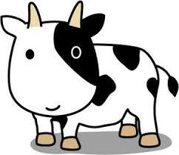

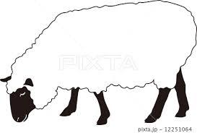


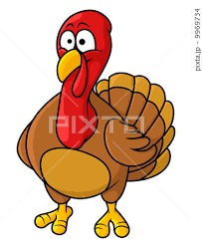
Do you like __?
Names of meats
ぶたにく（buta niku)
ぎゅうにく (gyuu niku)
とりにく (tori niku)
マトン (maton)
やぎにく (yagi niku)
うさぎのにく (usagi no niku)
しちめんちょうのにく
(shichimenchou no niku)

Slide 31
Dialog 2
A: なにがすきですか。
B: __＿がすきです。
A: なにがきらいですか。
B: ＿＿がきらいです。
A: Nani ga suki desu ka. (What do you like?)
B: ____ga suki desu. (I like ____.)
A: Nani ga kirai desu ka. (What do you dislike?)
B: ____ga kirai desu. (I dislike____.)

Slide 32
Popular food survey on graph assignment
Make a group based on the favorite food item from the ten items given.
Count the total of each item and write the number in a table on worksheet (D).
Make a bar graph on the worksheet based on the numbers found and make a list of best 10 food items.
Present the results by a representative of your group using the sentences:
わたしたちのグループは_＿にんで、＿＿がすきです。
Watashi no guruupu wa __nin de,___ga suki desu.
(Our group is __ persons and we like ＿＿.)
＿＿は（1 or 2 or …….) ばんめです。 (＿＿ wa __ban me desu. A is No. #.)
Hand in worksheet D as homework.

Slide 33
Dialog 2-1
A: なにがすきですか。
B: __＿がすきです。
A: なにがきらいですか。
B: ＿＿がきらいです。
A: nani ga suki desu ka. (What do you like?)
B: ____ga suki desu. (I like ____.)
A: nani ga kirai desu ka. (What do you dislike?)
B: ____ga kirai desu. (I dislike____.)
Add more food that you like or do not like to the list.

Slide 34
Homework
Create and write two of your own dialogs using dialog 2-1 on your own paper, and then use your own choice of food items that you like or dislike.
Practice to speak your own dialog (above) in pair in a class presentation.
Complete worksheet D for survey at home.

Slide 35
Day 4 Lesson

Slide 36
Topic of Day
Healthy or unhealthy food and school lunch time in US and Japan

Slide 37
Objectives
Students will be able to learn about similarities and differences in foods and school lunches in US and Japan.
Students will be able to select their own healthy foods.

Slide 38
Description of activities
Has students represent dialog 2 in pairs to class.
As review from lesson 3, asks students if they like healthy food using the following words.
Do you like (healthy food)? [ヘルシーフード(herushii fuudo)]
Has students show a variety of foods using the pictures and asks if they like them and if the food is healthy by using the following sentences.
Do you like ____? Is it healthy food? (learned as S + be-verb form)
Has students make a list of healthy and unhealthy food using the websites given and work on worksheet E.

Slide 39
Presentation assignment
Choose your own favorite and disliked food to present to class.
A: なにがすきですか。
B: __＿がすきです。
A: なにがきらいですか。
B: ＿＿がきらいです。
A: nani ga suki desu ka. (What do you like?)
B: ____ga suki desu. (I like ____.)
A: nani ga kirai desu ka. (What do you dislike?)
B: ____ga kirai desu. (I dislike____.)
Add more food that you like or do not like to the list.

Slide 40
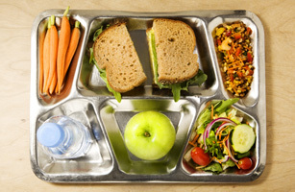
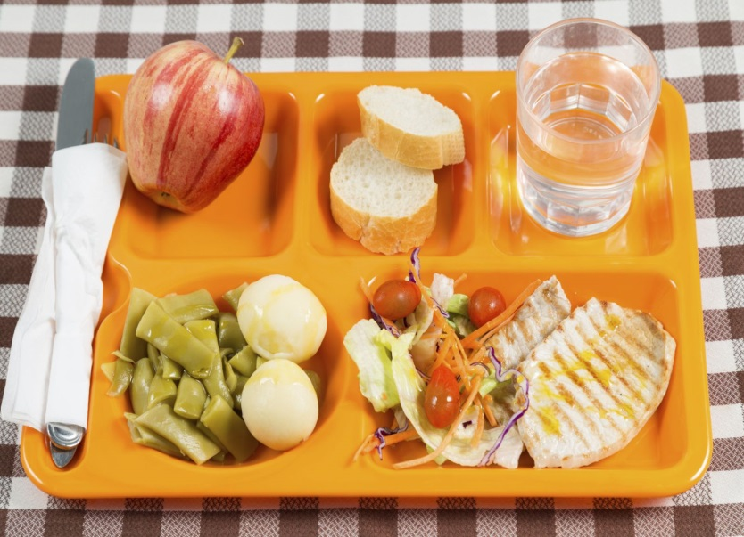
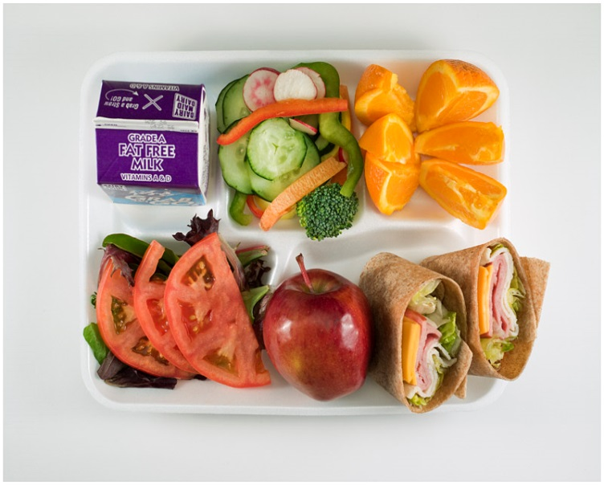
Healthy food or unhealthy food
Healthy food: ヘルシーフード、ヘルシーな たべもの
herushii fuudo or herushii na tabemono
Unhealthy food: ヘルシーじゃない たべもの
Herushii ja nai tabenomo.

Slide 41
Japanese school lunch
What are differences or similarities
in school lunch time between US and Japan?
School Lunch in Japan - It's Not Just About Eating!
Vegetable songs

Slide 42
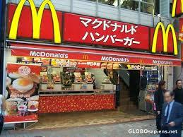
Did you know?
Burgers and Fast Food Burger King KFC McDonald’s Subway Wendy’s
Pizza Domino’s Pizza Pizza Hut
Red Lobster TGI Friday’s Krispy Kreme Baskin Robbins Starbucks
Denny’s El Torito Hard Rock Cafe Outback Steakhouse Rainforest Cafe

Slide 43
Assignment for healthy and unhealthy food
Make a list of healthy and unhealthy food using the websites given or your choices of reading materials and then work on worksheet E.
Assignment for similarities & differences
Write food items, school lunch, and others that you found in the categories in the worksheet F.

Slide 44
Homework
Complete worksheet E and F if not finished in class.

Slide 45
Day 5 Lesson

Slide 46
Topic of Day
Japanese table manners

Slide 47
Objectives
Students will be able to learn 2 greeting words related to eating meals.
Students will be able to use chopsticks
Students will be able to learn Japanese eating manners.

Slide 48
Description of activities
Has students practice two greeting words:
いただきます。(itadakimasu) ごちそうさまでした。(gochisousama deshita)
Has students watch YouTube about Japanese table manners.
Has students practice how to use chopsticks by using wooden ones.
Has students practice how to hold bowls when eating by using paper ones.
Gives worksheet G as homework.

Slide 49


Greeting words
いただきます。(itadakimasu)
ごちそうさまでした。(gochisousama deshita)

Slide 50
Eating manners
How to Eat a Typical Japanese Meal at Home |
Innovative Japanese Culture

Slide 51
Homework
Do worksheet G to write about this unit lesson to identify what and why you like and do not like.

Slide 52
References
Animals images
Gochisousama image
How to Eat a Typical Japanese Meal at Home | Innovative Japanese Culture
Itadakimasu image
NIHONGO ICHIBAN
School lunches
School lunches images
Cover Page image

